Slide 2
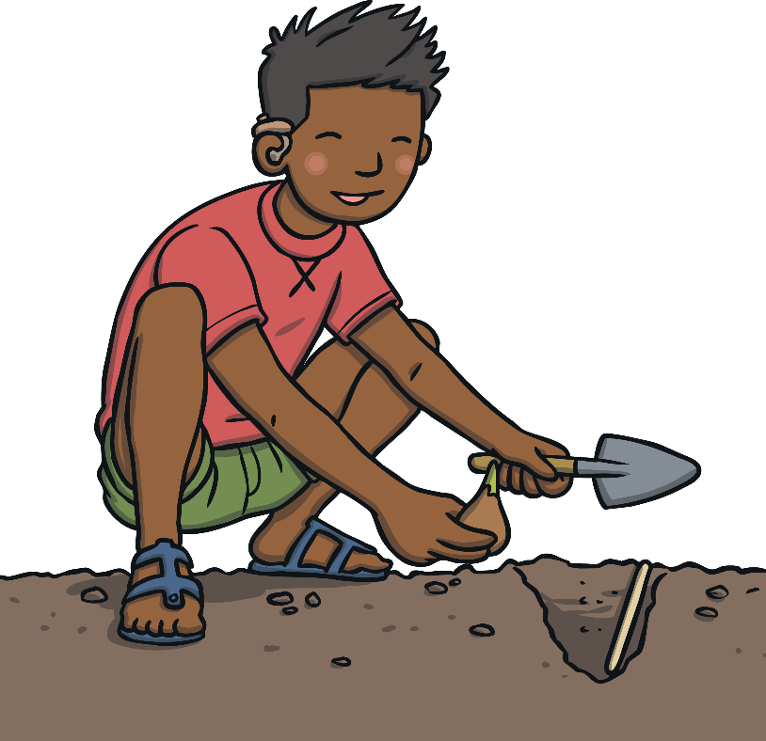
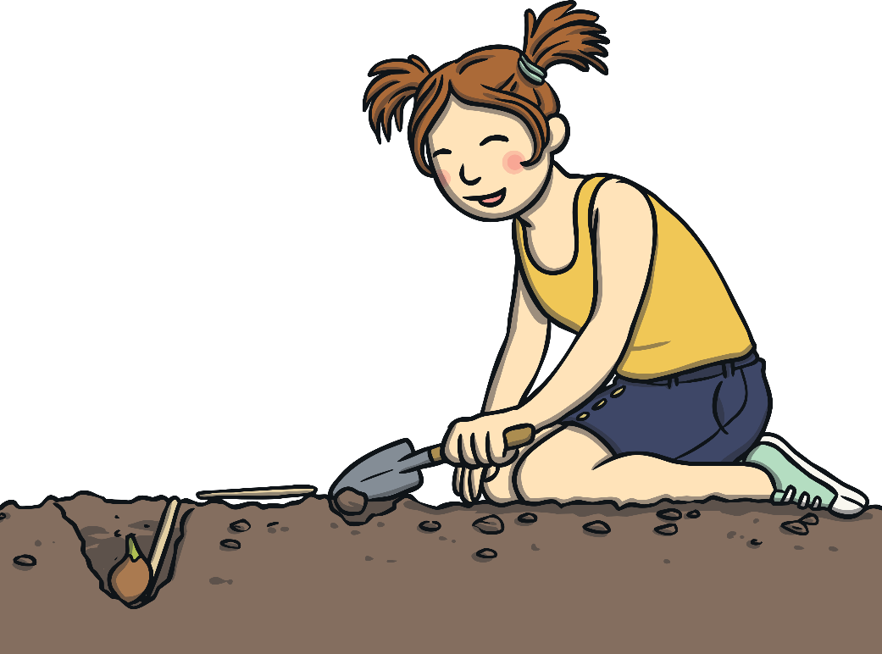
From a Seed to a Plant
The first step in the life cycle of a plant is the seed needs to
be planted in the soil.
The seed can be planted in a pot inside or in the ground outside.

Slide 3
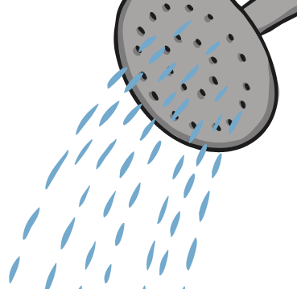

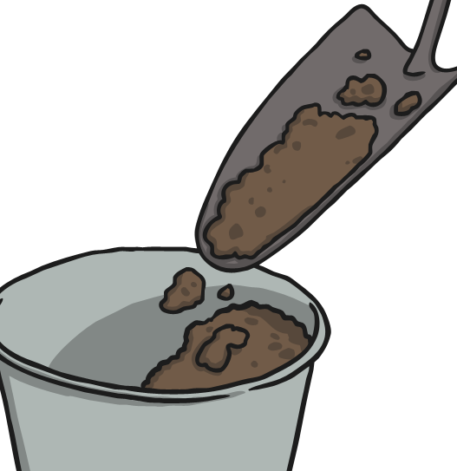
From a Seed to a Plant
A plant needs three things to grow:
water
sunlight
soil

Slide 4
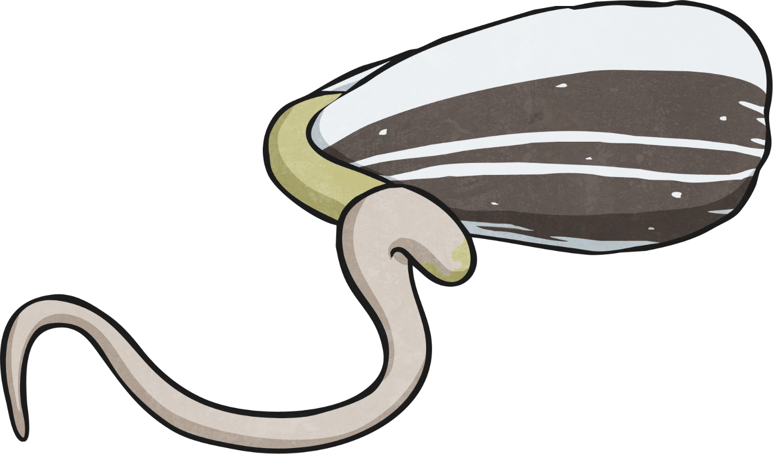
From a Seed to a Plant
Once the seed is planted in the soil and watered, it will take about one to two weeks before it starts to grow. This is called the germination stage.
Once the seed germinates, it will start to sprout and roots appear.
The roots help the plant get food and water from the soil.

Slide 5
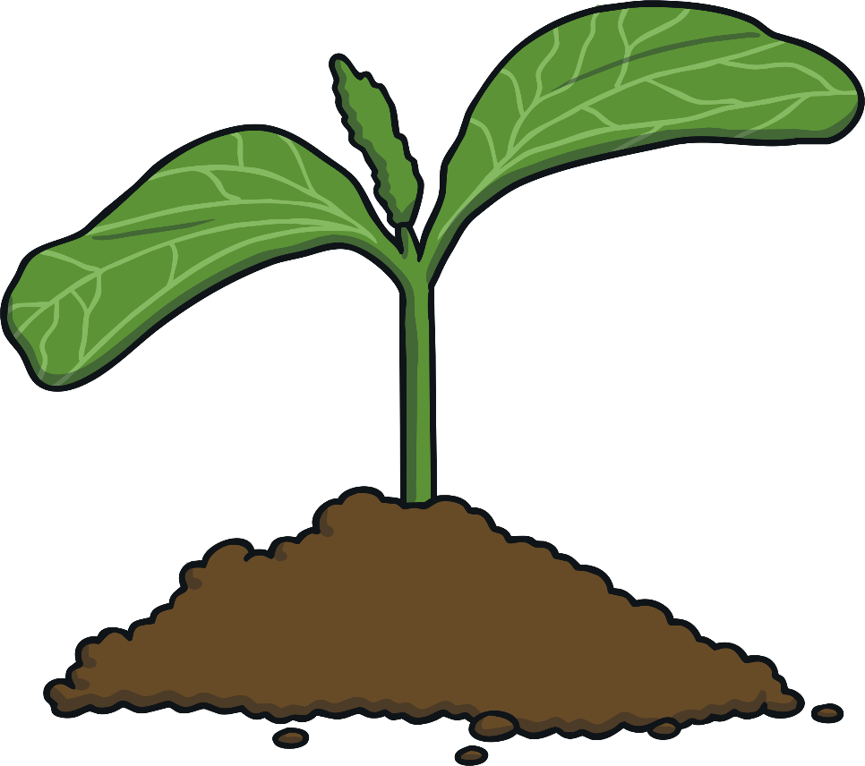
From a Seed to a Plant
In the next few weeks, the seed will begin to push through the soil.
It is now a seedling.
It is still very tiny during this stage and the roots will anchor it in the soil and keep it from blowing away.

Slide 6
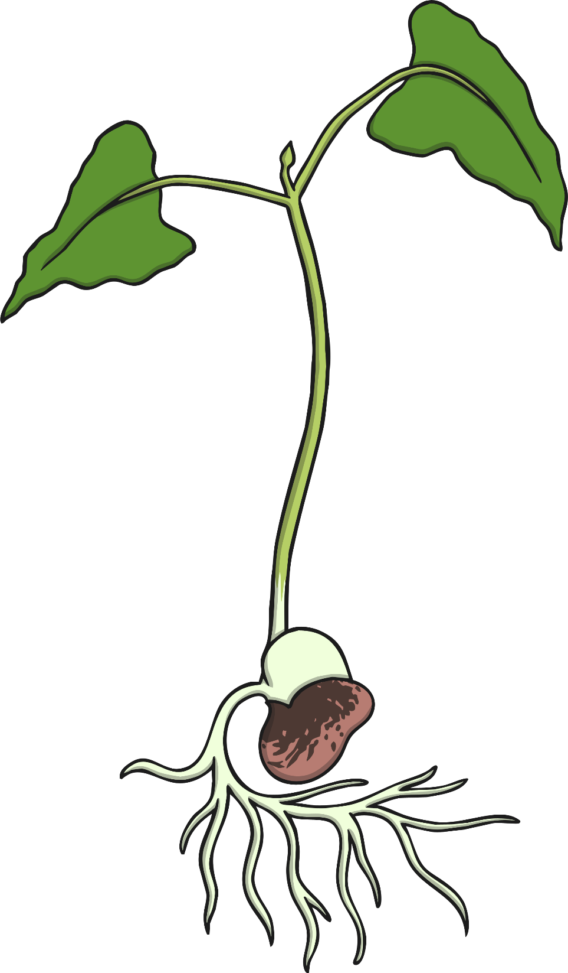
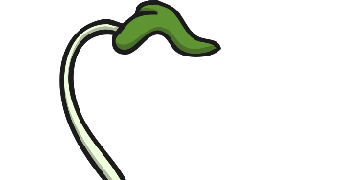
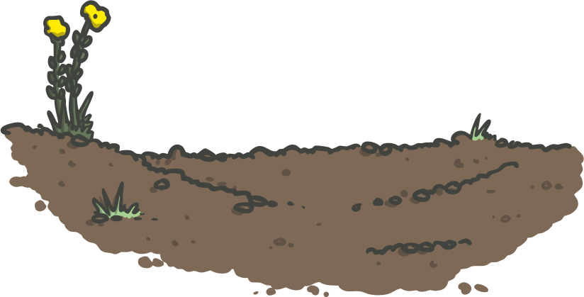
From a Seed to a Plant
As the seedling continues to grow, it will begin to get leaves and the stem will grow longer and longer. The stem helps the plant stand upright.
The stem also delivers water from the roots through tiny tubes. The leaves soak up the light and air to make food for the plant. This process is called photosynthesis.

Slide 7
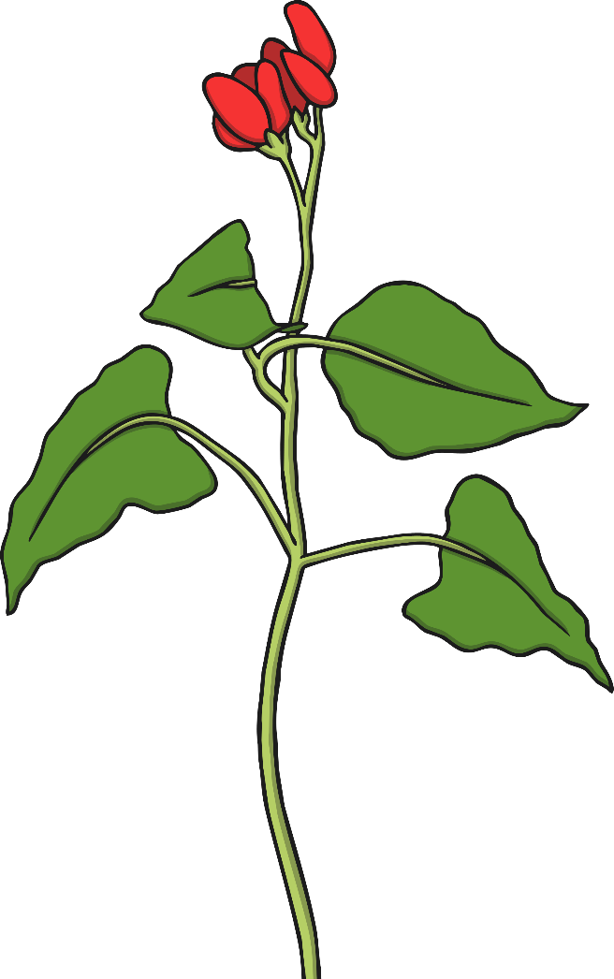
From a Seed to a Plant
A bud will begin to appear on the plant and it will turn into a flower. Depending on the type of seed planted, the flower may turn into either a fruit or vegetable or stay a flower.

Slide 8
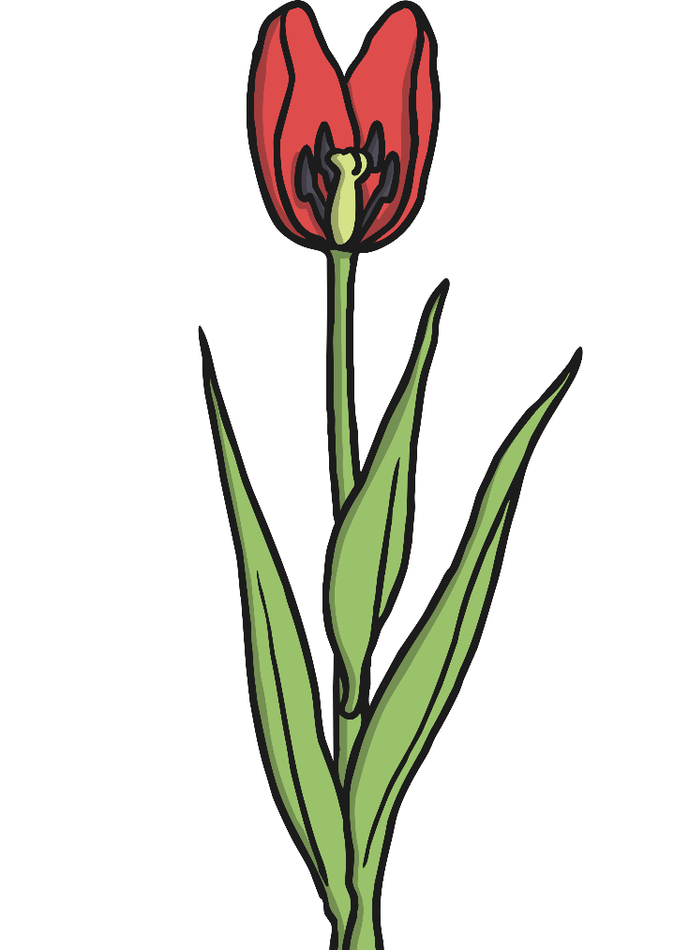
From a Seed to a Plant
Seeds are located in the center of the flower. Once the plant stops growing, it will drop seeds onto the ground.
Some seeds are spread by the wind or by animals. These seeds will begin to grow in the soil and the life cycle of the plant will repeat.

Slide 9

Higher Order Thinking Questions
What do you think would happen if a plant did not have sunlight or water?
Why does a plant need roots?
What do the leaves of a plant do?
How does a plant grow new plants?
If you could plant a garden, what kind of seeds would you plant?

